Slide 1
Top-k and Skyline Computation
Preference Queries Algorithms:

Slide 2
Outline of Presentation
Introduction
Top-k computation
  Algorithm FA (Fagin’s algorithm)
  Algorithm TA (threshold algorithm)
  Advanced topics
Skyline computation
  Dynamic Skyline
  Reverse Skyline
  SaLSa Algorithm
  Advanced topics

Slide 3
Introduction
In a database management system queries are usually expressed by using SQL. For example, to find the hotel names whose distance from the beach is at most 1km, how can we write the SQL statement ?

Slide 4
Introduction
In a database management system queries are usually expressed by using SQL. For example, to find the hotel names whose distance from the beach is at most 1km, we can write the following SQL statement:
SELECT hotels.name
FROM hotels
WHERE hotels.distance <= 1;

Slide 5
Introduction
In the previous query we specify exactly what we want, by stating that “hotels.distance <= 1”.
However, in many cases it is more convenient to let the system give the best possible answers it can get for us. This is even more helpful when multiple criteria are given by the user.

Slide 6
Introduction
Who is the best NBA player?
According to points: Tracy McGrady, score 2003
According to rebounds: Shaquille O'Neal, score 760
According to points+rebounds: Tracy McGrady, score 2487
Name | Points | Rebounds | Assists | Steals | ……
Tracy McGrady | 2003 | 484 | 448 | 135 | ……
Kobe Bryant | 1819 | 392 | 398 | 86 | ……
Shaquille O'Neal | 1669 | 760 | 200 | 36 | ……
Yao Ming | 1465 | 669 | 61 | 34 | ……
Dwyane Wade | 1854 | 397 | 520 | 121 | ……
Steve Nash | 1165 | 249 | 861 | 74 | ……
…… | …… | …… | …… | …… | ……

Slide 7
Introduction
Assume we are interested in hotels that are close to the beach AND close to a conference center. For a hotel x let Dbeach(x) denote the distance to the beach and Dconf(x) the distance to the conference center.
Assume further that we want the value Dbeach(x)+Dconf(x) to be the minimum possible.

Slide 8
Introduction
Object ranking based on Dbeach(x)+Dconf(x)
Dconf
id | Dbeach | Dconf | Score
a | 1 | 6 | 7
b | 3 | 4 | 7
c | 4 | 3 | 7
d | 3 | 1 | 4
e | 5 | 1 | 6
f | 2 | 2 | 4
g | 1 | 4 | 5
a (1,6)
g (1,4)
b (3,4)
0 1 2 3 4 5 6
c (4,3)
f (2,2)
d (3,1)
e (5,1)
Best hotels: d, f
Second best: g
Third best: e
Next best: a, b, c
Dbeach
0 1 2 3 4 5 6

Slide 9
Introduction – Top-k
Top-k Query
Given a database D of n objects, a scoring function F (according to which we rank the objects in D) and the number of expected answers k, a Top-k query returns the k objects with the best score (rank) in D.
In our hotel example, the scoring function F(x) is simply the sum of Dbeach(x)+Dconf(x).

Slide 10
Introduction – Top-k
Monotonicity property
Assume we have two vectors X and Y
X = (x1, x2, …, xm) and Y = (y1, y2, …, ym)
A scoring function F() is called monotone increasing if it preserves the order:
x1 <= y1, …, xm < ym → F(X) <= F(Y)
Examples: min, max, sum

Slide 11
Introduction – Top-k
Remarks
The number of objects in the answer (k) is user-defined.
The “best” score is either the lowest or the highest depending on user preferences.
The ranking function F, may involve more than two attributes.

Slide 12
Introduction – Top-k
Top-k query in SQL
SELECT hotels.name
FROM hotels
ORDER BY (hotels.Dbeach+hotels.Dconf)
STOP AT 3
This is a Top-3 query.

Slide 13
Introduction – Top-k
In a Top-k query the ranking function F as well as the number of answers k must be provided by the user.
In many cases it is difficult to define a meaningful ranking function, especially when the attributes have different semantics (e.g., find the cheapest hotel closer to the beach).

Slide 14
Introduction – Skyline
To avoid the drawbacks of Top-k queries, Skyline queries have been proposed as an alternative to satisfy user preferences.
The Skyline query
  does not require a ranking function
  does not need the integer k

Slide 15
Introduction - Skyline
The Skyline of a set of objects (records) comprises all records that are not dominated by any other record.
A record x dominates another record y if x is as good as y in all attributes and strictly better in at least one attribute.
Again, in some cases we are interested in minimizing attribute values (e.g., price) and in other cases maximizing them (e.g., floor number)

Slide 16
Introduction - Skyline
Dconf
Domination examples:
g dominates b because 1<3 and 4=4
f dominates c because 2<4 and 2<3
d dominates e because 3<5 and 1=1
dominated
a (1,6)
g (1,4)
b (3,4)
0 1 2 3 4 5 6
c (4,3)
The Skyline is the set: { g, f, d }
These objects are not dominated
by any other object.
f (2,2)
d (3,1)
e (5,1)
Dbeach
0 1 2 3 4 5 6
not dominated

Slide 17
Introduction - applications
E-commerce
“I want to buy a Smartphone which is as cheap as possible, has large memory capacity and it is light-weighted”
For Top-k queries we should also provide the number k (how many Smartphones we want in the answer) and the ranking function.

Slide 18
Introduction - applications
Multimedia Databases
“Give me the 3 images that have the highest resolution, they are red and depict flowers”

Slide 19
Introduction - applications
Web Information Retrieval
Let M be a meta search engine which uses yahoo and google. Both search engines return a set of results ranked by relevance.
yahoo
google
id | score | id | score
a | 0.9 | b | 0.8
c | 0.7 | d | 0.7
b | 0.6 | a | 0.6
The challenge is to combine the results of all search engines in order to give a total ranking of the documents.

Slide 20
Introduction – naïve methods
It is possible to process Top-k and Skyline queries by using simple algorithmic techniques. However, although these techniques are easily implemented, they suffer from performance degradation due to their large complexities.

Slide 21
Introduction – naïve methods
Top-k processing
Apply the ranking function F to all objects
Sort the objects with respect to their score
Return the k best objects
Disadvantages:
Sorting is an expensive operation requiring a complexity of O(n logn) for n elements. Usually, k is very small in comparison to the number of objects, so we pay too much!

Slide 22
Introduction – naïve methods
Skyline processing
For each object, check if it is dominated by any other object
Return the objects that are not dominated
Disadvantages:
Requires scanning the whole database for each object. Complexity O(n^2). This is not convenient in systems with large volumes of data.

Slide 23
Introduction - motivation
Since naïve methods do not perform well for large sets of objects, the challenge is to devise new algorithms in order to process Top-k and Skyline queries efficiently.
Goals:
  avoid sorting operations in Top-k
  avoid scanning the whole database in Skyline

Slide 24
Top-k Computation
Application: multimedia information retrieval
We have an image database composed of n image objects O1, O2, …, On.
Each object Oi is described by m attributes ai1, ai2, …, aim.
Therefore, each object is a vector in the m-th dimensional space.
We assume that the total score of an image is the sum of the individual scores of all attributes.

Slide 25
Top-k Computation
The database can be considered as an n x m score matrix, storing the score values of every object in every attribute.
a1 | a2 | a3 | a4 | a5
O3, 99 | O1, 91 | O1, 92 | O3, 74 | O3, 67
O1, 66 | O3, 90 | O3, 75 | O1, 56 | O4, 67
O0, 63 | O0, 61 | O4, 70 | O0, 56 | O1, 58
O2, 48 | O4, 07 | O2, 16 | O2, 28 | O2, 54
O4, 44 | O2, 01 | O0, 01 | O4, 19 | O0, 35
Note that, for each attribute scores are sorted in descending order.

Slide 26
Top-k Computation
A user issues a Top-2 query:
“Given the query image Q, retrieve the 2 images from the database that best match the query”
(This is a typical query in content-based retrieval of images)

Slide 27
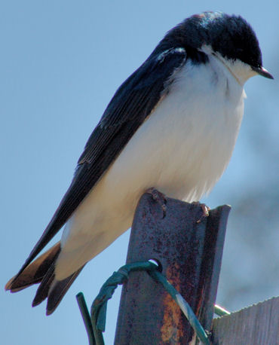
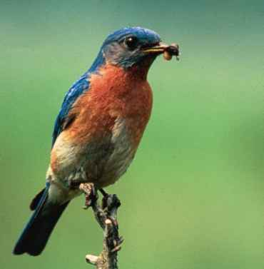

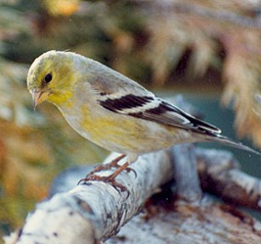


Top-k Computation
Assume that the database contains only 5 image objects O0, O1, O2, O3 and O4.
Image Database
query image Q
O1
O3
O4
O0
?
O2
Top-2
images

Slide 28

Top-k Computation – FA algorithm
Fagin’s Algorithm (FA) is the first
important contribution in the area.
The algorithm is based on two types of accesses:
Sorted access on attribute ai: retrieves the next object in the sorted list of ai
Random access on attribute ai: gives the value of the i-th attribute for a specific object identifier.

Slide 29
Top-k Computation – FA algorithm
Step 1:
Read attributes from every sorted list using sorted access
Stop when k objects have been seen in common from all lists
a1 | a2 | a3 | a4 | a5
O3, 99 | O1, 91 | O1, 92 | O3, 74 | O3, 67
O1, 66 | O3, 90 | O3, 75 | O1, 56 | O4, 67
O0, 63 | O0, 61 | O4, 70 | O0, 56 | O1, 58
O2, 48 | O4, 07 | O2, 16 | O2, 28 | O2, 54
O4, 44 | O2, 01 | O0, 01 | O4, 19 | O0, 35
id | a1 | a2 | a3 | a4 | a5
O3 99 90 75 74 67
O1 66 91 92 56 58
O4 70 67
O0 63 61 56
No more sorted accesses are required, since we have determined k=2
objects contained in all lists (objects O1 and O3).

Slide 30
Top-k Computation – FA algorithm
Step 2:
Use random access to find missing scores
a1 | a2 | a3 | a4 | a5
O3, 99 | O1, 91 | O1, 92 | O3, 74 | O3, 67
O1, 66 | O3, 90 | O3, 75 | O1, 56 | O4, 67
O0, 63 | O0, 61 | O4, 70 | O0, 56 | O1, 58
O2, 48 | O4, 07 | O2, 16 | O2, 28 | O2, 54
O4, 44 | O2, 01 | O0, 01 | O4, 19 | O0, 35
id | a1 | a2 | a3 | a4 | a5
O3 99 90 75 74 67
O1 66 91 92 56 58
44
19
O4 70 67
07
O0 63 61 56
01
35
All missing values for seen objects have been determined.
Therefore, no more random accesses are required.

Slide 31
Top-k Computation – FA algorithm
Step 3:
Compute the scores of the seen objects.
Return the k highest scored objects.
Total Score
id | a1 | a2 | a3 | a4 | a5
O3 99 90 75 74 67
405
Top-2
O1 66 91 92 56 58
363
44
19
207
O4 70 67
07
O0 63 61 56
216
01
35
Therefore, the two images that best match the query image are:
O3 with score 405 and O1 with score 363.

Slide 32
Top-k Computation – TA algorithm
Fagin and his colleagues performed some enhancements to FA, leading to algorithm TA (Threshold Algorithm).
The main contribution of this new algorithm is the incorporation of a threshold to determine when to stop scanning the sorted lists.

Slide 33
Top-k Computation – TA algorithm
Step 1:
Read attributes from every sorted list using sorted access.
For each object seen x:
  Use random access to find missing values.
  Determine the score F(x) of object x.
  If the object is among the top-k keep it in buffer.
BUFFER:
(O3, 405)
(O1, 363)
a1 | a2 | a3 | a4 | a5
O3, 99 | O1, 91 | O1, 92 | O3, 74 | O3, 67
O1, 66 | O3, 90 | O3, 75 | O1, 56 | O4, 67
O0, 63 | O0, 61 | O4, 70 | O0, 56 | O1, 58
O2, 48 | O4, 07 | O2, 16 | O2, 28 | O2, 54
O4, 44 | O2, 01 | O0, 01 | O4, 19 | O0, 35
id | a1 | a2 | a3 | a4 | a5 | F
p=1
O3 99 90 75 74 67 405
O1 66 91 92 56 58 363

Slide 34
Top-k Computation – TA algorithm
Step 2:
Determine threshold value T based on objects currently seen under sorted access. T = a1(p) + a2(p) + … + am(p) where p is the current sorted access position.
If there are k objects with total scores >= T then STOP and report answers else p = p + 1 and GOTO Step1.
BUFFER:
(O3, 405)
(O1, 363)
a1 | a2 | a3 | a4 | a5
O3, 99 | O1, 91 | O1, 92 | O3, 74 | O3, 67
O1, 66 | O3, 90 | O3, 75 | O1, 56 | O4, 67
O0, 63 | O0, 61 | O4, 70 | O0, 56 | O1, 58
O2, 48 | O4, 07 | O2, 16 | O2, 28 | O2, 54
O4, 44 | O2, 01 | O0, 01 | O4, 19 | O0, 35
id | a1 | a2 | a3 | a4 | a5 | F
 |  |  |  |  |  | 405
 |  |  |  |  |  | 363
p=1
O3 99 90 75 74 67
O1 66 91 92 56 58
T = 99+91+92+74+67 = 423
There are NO k objects with a score >= T, GOTO Step1 …

Slide 35
Top-k Computation – TA algorithm
Step 1 (second execution):
Read attributes from every sorted list using sorted access.
For each object seen x:
  Use random access to find missing values.
  Determine the score F(x) of object x.
  If the object is among the top-k keep it in buffer.
BUFFER:
(O3, 405)
(O1, 363)
a1 | a2 | a3 | a4 | a5
O3, 99 | O1, 91 | O1, 92 | O3, 74 | O3, 67
O1, 66 | O3, 90 | O3, 75 | O1, 56 | O4, 67
O0, 63 | O0, 61 | O4, 70 | O0, 56 | O1, 58
O2, 48 | O4, 07 | O2, 16 | O2, 28 | O2, 54
O4, 44 | O2, 01 | O0, 01 | O4, 19 | O0, 35
id | a1 | a2 | a3 | a4 | a5 | F
O3 99 90 75 74 67 405
p=2
O1 66 91 92 56 58 363
O4 44 07 70 19 67 207

Slide 36
Top-k Computation – TA algorithm
Step 2 (second execution):
Determine threshold value T based on objects currently seen under sorted access. T = a1(p) + a2(p) + … + am(p) where p is the current sorted access position.
If there are k objects with total scores >= T then STOP and report answers else p = p + 1 and GOTO Step1.
BUFFER:
(O3, 405)
(O1, 363)
a1 | a2 | a3 | a4 | a5
O3, 99 | O1, 91 | O1, 92 | O3, 74 | O3, 67
O1, 66 | O3, 90 | O3, 75 | O1, 56 | O4, 67
O0, 63 | O0, 61 | O4, 70 | O0, 56 | O1, 58
O2, 48 | O4, 07 | O2, 16 | O2, 28 | O2, 54
O4, 44 | O2, 01 | O0, 01 | O4, 19 | O0, 35
id | a1 | a2 | a3 | a4 | a5 | F
O3 99 90 75 74 67 405
p=2
O1 66 91 92 56 58 363
O4 44 07 70 19 67 207
T = 66+90+75+56+67 = 354
Both objects in the buffer have scores higher than T. STOP and report answers.

Slide 37
Top-k Computation - FA vs TA
TA sees less objects than FA
  TA stops at least as early as FA
    When we have seen k objects in common in FA, their scores are higher or equal than the threshold in TA.
TA may perform more random accesses than FA
  In TA, (m-1) random accesses for each object.
  In FA, random accesses are done at the end, only for missing scores.
TA requires only bounded buffer space (k) at the expense of more random seeks.
FA makes use of unbounded buffers.

Slide 38
Top-k Computation - advanced topics I
Distributed Top-k computation
Data are frequently distributed across a number of machines. The challenge in such an environment is to determine the Top-k answers trying to minimize the network traffic and the latency.
Specialized algorithms have been proposed that work efficiently in a distributed environment.

Slide 39
Top-k Computation - advanced topics II
Top-k queries on probabilistic data
In several applications there is uncertainty in the data. For example, values may be missing or we are not sure about an existing value. A challenging research direction is to investigate algorithms for Top-k computation in such a case.

Slide 40
Skyline Computation
Remember that:
Top-k query processing requires a user-defined ranking function F and an integer k to declare the number of best objects in the answer.
On the other hand, Skyline query processing does NOT require any of these.

Slide 41
Skyline Computation
Top-k
Skyline
Dconf
Dconf
a (1,6)
a (1,6)
g (1,4)
b (3,4)
g (1,4)
b (3,4)
0 1 2 3 4 5 6
0 1 2 3 4 5 6
c (4,3)
c (4,3)
f (2,2)
f (2,2)
d (3,1)
e (5,1)
d (3,1)
e (5,1)
0 1 2 3 4 5 6
Dbeach
0 1 2 3 4 5 6
Dbeach
f, d (best objects)
Skyline objects: g, f, d
g (next best)
e (next best)

Slide 42
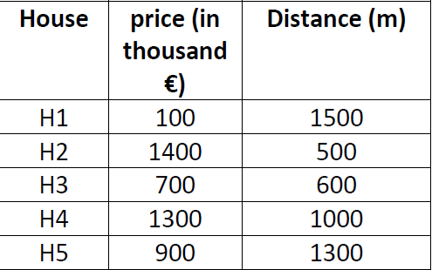
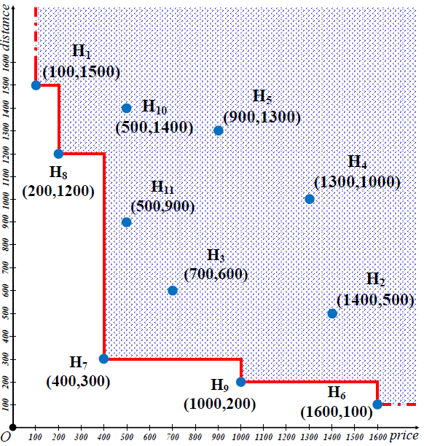
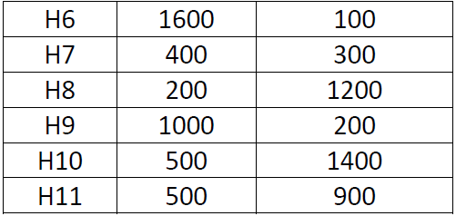
Skyline Computation
Skyline

Slide 43

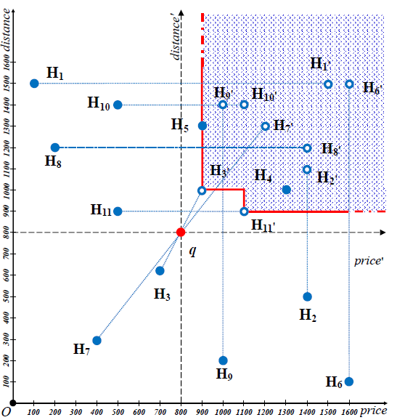
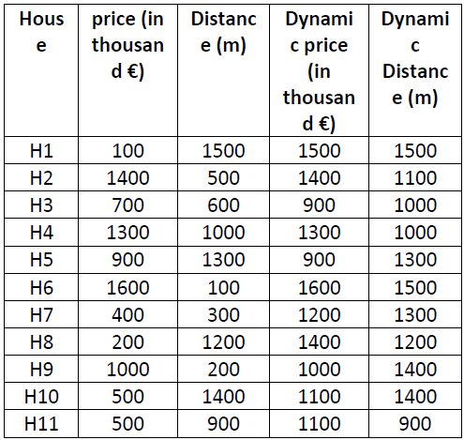
Dynamic Skyline
q = (800,800)
q = buyer preferences

Slide 44
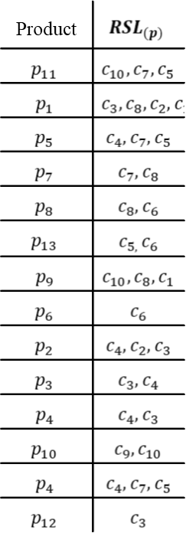
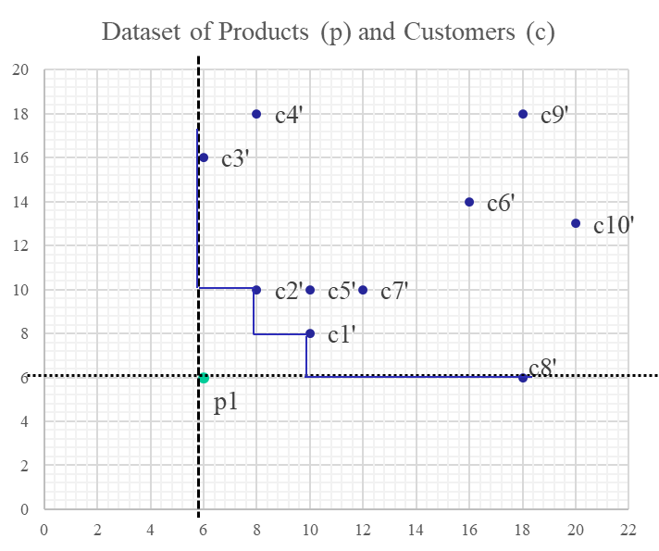
Dynamic Skyline & Reverse Skyline
Product | X | Y
p1 | 6 | 6
p2 | 4 | 18
p3 | 6 | 20
p4 | 9 | 15
p5 | 12 | 18
p6 | 16 | 14
p7 | 12 | 6
p8 | 16 | 6
p9 | 20 | 8
p10 | 20 | 20
Customer | X | Y
c1 | 2 | 8
c2 | 4 | 10
c3 | 6 | 16
c4 | 8 | 18
c5 | 10 | 10
c6 | 16 | 14
c7 | 12 | 2
c8 | 18 | 6
c9 | 18 | 18
c10 | 20 | 13

Slide 45
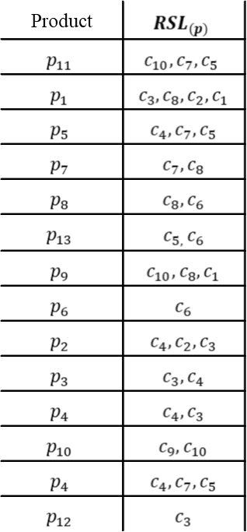
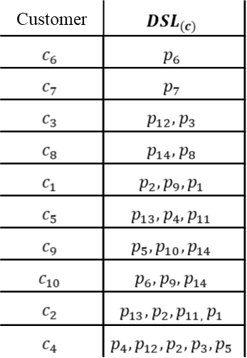
Dynamic Skyline & Reverse Skyline

Slide 46
SaLSa (Sort And Limit Skyline Algorithm)
SaLSa does not have an index structure and is the first algorithm that exploits the values of a monotone scoring (limiting) function to sort the dataset and effectively limit the number of point to be read and compared by using a threshold value.

Slide 47
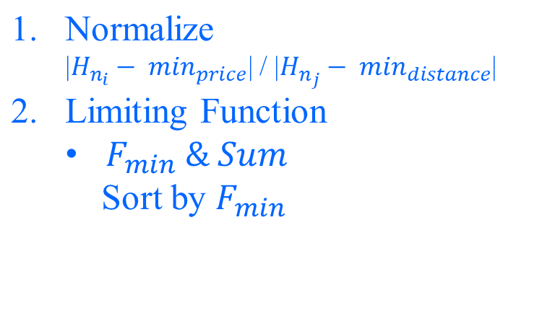
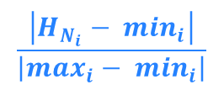
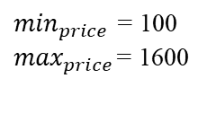
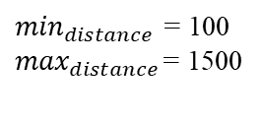
SaLSa (Sort And Limit Skyline Algorithm)
Normalize |  |  | F_{min} | Sum |  | Sort by
House | Price ($) | Distance |  |  |  | F_{min}
H1 | 0 | 1 | 0 | 1 |  | H1
H2 | 0.867 | 0.286 | 0.286 | 1.152 |  | H6
H3 | 0.4 | 0.357 | 0.357 | 0.757 |  | H8
H4 | 0.8 | 0.643 | 0.643 | 1.443 |  | H9
H5 | 0.533 | 0.857 | 0.533 | 1.390 |  | H7
H6 | 1 | 0 | 0 | 1 |  | H11
H7 | 0.2 | 0.143 | 0.143 | 0.343 |  | H10
H8 | 0.067 | 0.786 | 0.067 | 0.852 |  | H2
H9 | 0.6 | 0.071 | 0.071 | 0.671 |  | H3
H10 | 0.267 | 0.929 | 0.267 | 1.195 |  | H5
H11 | 0.267 | 0.571 | 0.267 | 0.838 |  | H4

Slide 48
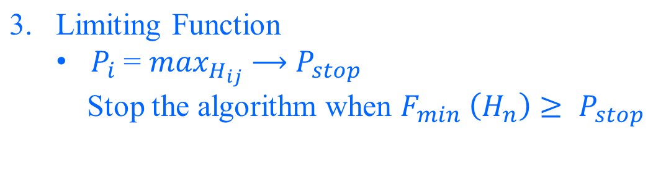
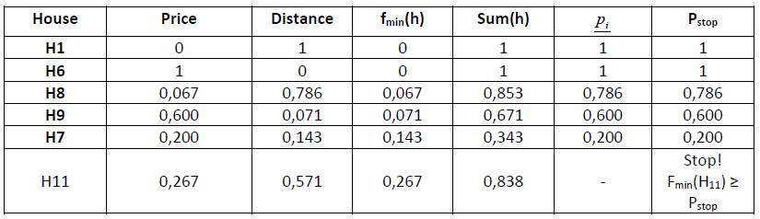
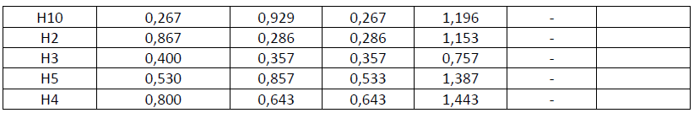
SaLSa (Sort And Limit Skyline Algorithm)

Slide 49
Skyline Computation - advanced topics I
Skylines in subspaces
When the number of attributes (dimensions) increases, the number of points contained in the Skyline increases substantially. This happens because the probability that a point dominates another decreases.
Solution: find the Skyline on a subset of the attributes instead of using the whole set of attributes.

Slide 50
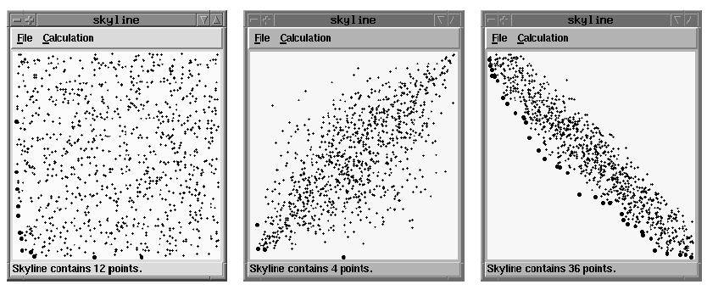
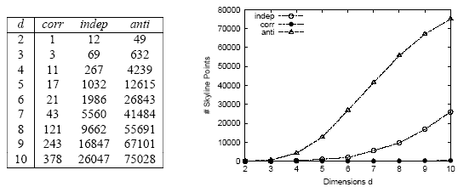
Skyline Computation - advanced topics I
independent
correlated
anticorrelated
100,000 points
(source: Borzonyi et al ICDE 2001)

Slide 51
Skyline Computation - advanced topics II
Distributed Skylines
In several applications, data are distributed across different sites (e.g., web applications, P2P). A number of research contributions deal with efficient processing of Skyline queries in such an environment.

Slide 52
Skyline Computation - advanced topics III
Most important Skyline objects
The number of Skyline points may be large in some cases. The challenge is to rank the Skyline points according to a score. For example, each Skyline point may be ranked according to the number of points it dominates. The highly-ranked points are presented to the user.

Slide 53
Conclusions
Preference queries are very important in database systems.
Preferences are expressed by minimization or maximization criteria on the attributes (dimensions).
Important queries: Top-k and Skylines
Top-k query: requires a scoring function F() and an integer k and returns the k best objects according to F().
Skyline query: requires the preferences regarding minimization or maximization and returns the dominant objects (not dominated by others).

Slide 54
Conclusions
For Top-k we discussed part of Fagin’s work (FA and TA algorithms).
For Skylines we discussed the SaLSa (Sort And Limit Skyline Algorithm) algorithm which performs scoring (limiting) function to sort the dataset and effectively limit the number of point to be read .
Both Top-k and Skylines offer a convenient way to select the best objects from a database, when multiple criteria are considered.

Slide 55
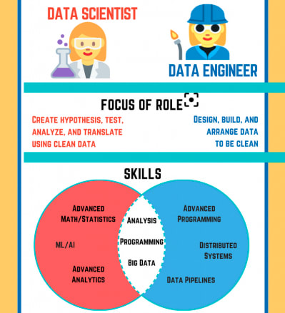
Conclusions
Data Science vs Data Engineering

Slide 56
Conclusions
Research Trends
Find efficient indexing schemes to speed-up the processing of Top-k and Skyline queries. (DE)
Algorithms to process approximate answers (less accurate but faster). (DE)
Preference queries in distributed environments. (DE)

